Slide 1
Introduction to UNIX & LINUX
History of UNIX and LINUX.
Basic concepts of Operating System,
Kernel, Shell & File System structure.
Basic concepts of Linux
Differences between CentOS, Red Hat
Enterprise Linux & Fedora.
Basic commands of Linux.

Slide 2
History of UNIX & LINUX
UNIX was developed in 1969 at AT&T Bell Labs.
Many variants since then: BSD, Solaris, Mac
OS X, Linux .
The Linux kernel was first developed in 1991 by
Linus Torvalds, a student at the University of
Helsinki
Linux has been widely adopted for servers and
HPC systems

Slide 3
Basic concepts of Operating System
An operating system (OS) is software that communicates with the hardware and allows other programs to run. It is comprised of system software, or the fundamental files your computer needs to boot up and function. Every desktop computer, tablet, and smartphone includes an operating system that provides basic functionality for the device.
Following are some of important functions of an operating System.
Memory Management :
Processor Management :
Device Management :
File Management :
Security :
Control over system performance :
Job accounting :
Error detecting aids :
Coordination between other software and users :

Slide 4
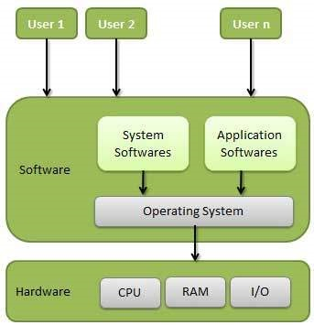
Basic concepts of Operating System

Slide 5
Basic concepts of Operating System
The kernel is the central module of an operating system (OS). It is the part of the operating system that loads first, and it remains in main memory. Because it stays in memory, it is important for the kernel to be as small as possible while still providing all the essential services required by other parts of the operating system and applications. The the kernel code is usually loaded into a protected area of memory to prevent it from being overwritten by programs or other parts of the operating system.
The main tasks of the kernel are :
Process management :
Device management :
Memory management :
Interrupt handling :
I/O communication :
File system... etc.

Slide 6
Basic concepts of Operating System
In computing, a shell is a user interface for access to an operating system's services. In general, operating system shells use either a command-line interface (CLI) or graphical user interface (GUI), depending on a computer's role and particular operation.
The shell is a program that takes command typed bu the usaer and calls the operating system to run those command.
Shelll accepts your instruction or command and translate it into computer binary language.
You can use shell script to automate admini task.
Kind of Shell :-
Bourne shell
C shell
Korn shell
Bash shell
Tcsh shell

Slide 7
Basic concepts of Operating System
An operating system's file system structure is its most basic level of organization. Almost all of the ways an operating system interacts with its users, applications, and security model are dependent upon the way it organizes files on storage devices.
In Linux, everything is configured as a file. This includes not only text files, images and compiled programs (also referred to as executables), but also directories, partitions and hardware device drivers.

Slide 8
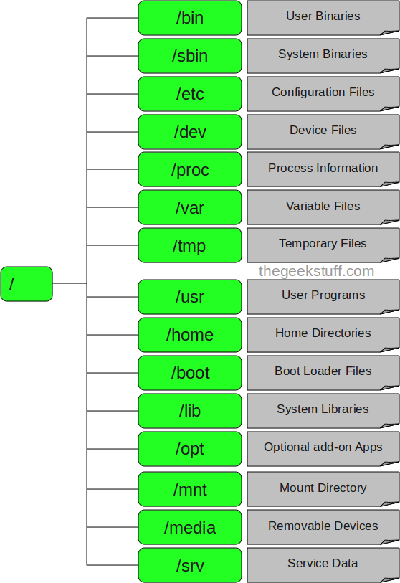

Slide 9
Basic commands of Linux
mkdir – make directories
Usage: mkdir [OPTION] DIRECTORY...
eg. mkdir prabhat
ls – list directory contents
Usage: ls [OPTION]... [FILE]...
eg. ls, ls ­l, ls prabhat
cd – changes directories
Usage: cd [DIRECTORY]
eg. cd prabhat
pwd -- print name of current working directory
Usage: pwd
vim – Vi Improved, a programmers text editor
Usage: vim [OPTION] [file]...
eg. vim file1.txt

Slide 10
Basic commands of Linux
rm - remove files or directories
Usage: rm [OPTION]... FILE...
eg. rm file1.txt , rm ­rf some_dir
find – search for files in a directory hierarchy
Usage: find [OPTION] [path] [pattern]
eg. find file1.txt, find ­name file1.txt
history – prints recently used commands
Usage: history
cat – concatenate files and print on the standard output
Usage: cat [OPTION] [FILE]...
eg. cat file1.txt file2.txt
cat ­n file1.txt
• echo – display a line of text
Usage: echo [OPTION] [string] ...
eg. echo I love India
echo $HOME

Slide 11
Basic commands of Linux
ps – report a snapshot of the current processes
Usage: ps [OPTION]
eg. ps, ps ­el
kill – to kill a process(using signal mechanism)
Usage: kill [OPTION] pid
eg. kill ­9 2275
tar – to archive a file
Usage: tar [OPTION] DEST SOURCE
eg. tar ­cvf /home/archive.tar /home/original
tar ­xvf /home/archive.tar
• zip – package and compress (archive) files
Usage: zip [OPTION] DEST SOURSE
eg. zip original.zip original
• unzip – list, test and extract compressed files in a ZIP archive
Usage: unzip filename
eg. unzip original.zip

